Slide 1


CAPSTONE PROJECT
TechCrush Capstone Project
TOPIC 1:
Incident Response Playbooks
Disclaimer: This training material belongs to techcrush and shouldn’t be shared

Slide 2
CAPSTONE PROJECT
Outline
TITLE
AIM AND OBJECTIVE
METHODOLOGY
CONCEPT OF PROJECT
TOOLS USED
IMAGE
PLAYBOOK 1.1 [WEBSITE DEFACEMENT]
PLAYBOOK 1.2 [INSIDER THREAT]
PLAYBOOK 1.3 [PHISHING TO MALWARE DELIVERY]
OVERALL BENEFITS
CONCLUSION
REFERENCES
THANK YOU
Disclaimer: This training material belongs to techcrush and shouldn’t be shared

Slide 3
CAPSTONE PROJECT
Title
Protecting Our Organization from Cyber Threats
Using
3 Critical Security Scenarios:
• Website Hacking
• Employee Data Theft
• Phishing & Malware Attacks
Disclaimer: This training material belongs to techcrush and shouldn’t be shared

Slide 4
CAPSTONE PROJECT
Aim
To strengthen the organization’s cyber resilience by developing actionable, role-based response when it gets attacked.
Objectives
Ensure fast detection & containment of threats.
Follow standard procedures across incident types.
Minimize Response Time.
Drive Continuous Improvement through lessons learned
Disclaimer: This training material belongs to techcrush and shouldn’t be shared

Slide 5
CAPSTONE PROJECT
Methodology
Each playbook tells us what to do, step by step.
1.Identify the threat and risk impact.
Define detection indicators and triggers.
Response phases: detection → containment → eradication → recovery.
Assign roles and responsibilities.
Include communication strategy and escalation paths if any.
Develop metrics for response effectiveness (MTTD, MTTR, MTTC, etc.).
Include technical and human response components.
Disclaimer: This training material belongs to techcrush and shouldn’t be shared

Slide 6
CAPSTONE PROJECT
  Concept of project
This is a scenario-based response for predictable and repeatable actions that uses tools, alerts, Human coordination, logs and report to defend against threats. Each playbook targets one core attack vector and defines preventive and reactive controls.
Disclaimer: This training material belongs to techcrush and shouldn’t be shared

Slide 7
CAPSTONE PROJECT
Tools Used
Function | Tools | Purpose
Monitoring & Detection | SIEM, EDR, DLP, UptimeRobot, Datadog | Detect anomalies and alerts
Forensics & Analysis | Wireshark, FTK, WPScan, EnCase | Evidence collection and malware tracing
Containment | NAC, Firewall, VPN revocation, AD | Restrict threat spread
Communication | Secure chat, Jira, Ticketing system | Team coordination
Recovery | Backups, Git, Reimaging, Patch management | Restore safe operations
Disclaimer: This training material belongs to techcrush and shouldn’t be shared

Slide 8
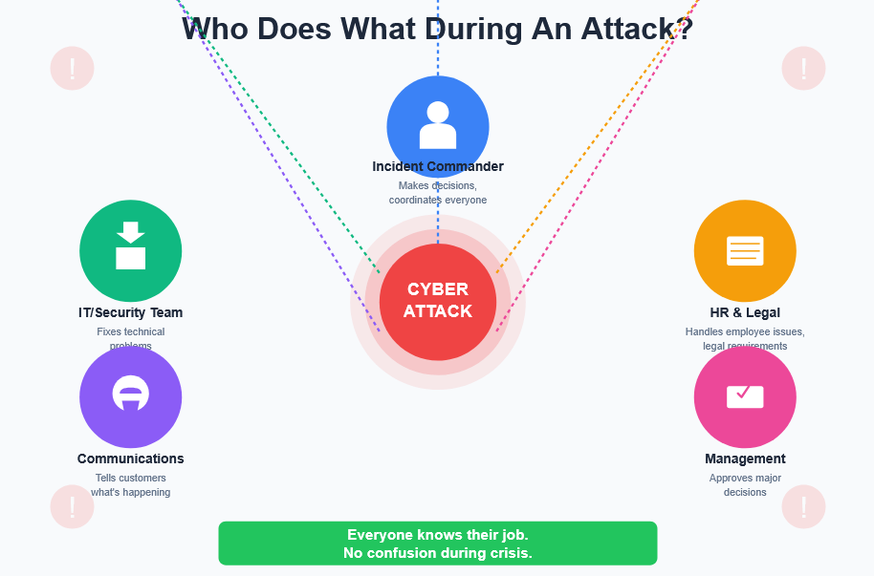
CAPSTONE PROJECT
Disclaimer: This training material belongs to techcrush and shouldn’t be shared

Slide 9
CAPSTONE PROJECT
Website Defacement Playbook: Design Rationale
Scope: Fast Public Containment (30-min target) via server exploits.
Phases: Detection → Containment (maintenance mode, isolate servers) → Eradication (remove malicious files) → Recovery (restore verified backups).
Clear Roles Separation: Web Dev, DevOps, Security Analyst, PR, Legal, Product Manager.
Metrics Dashboard: Measures detection, containment, and resolution time.
Disclaimer: This training material belongs to techcrush and shouldn’t be shared

Slide 10
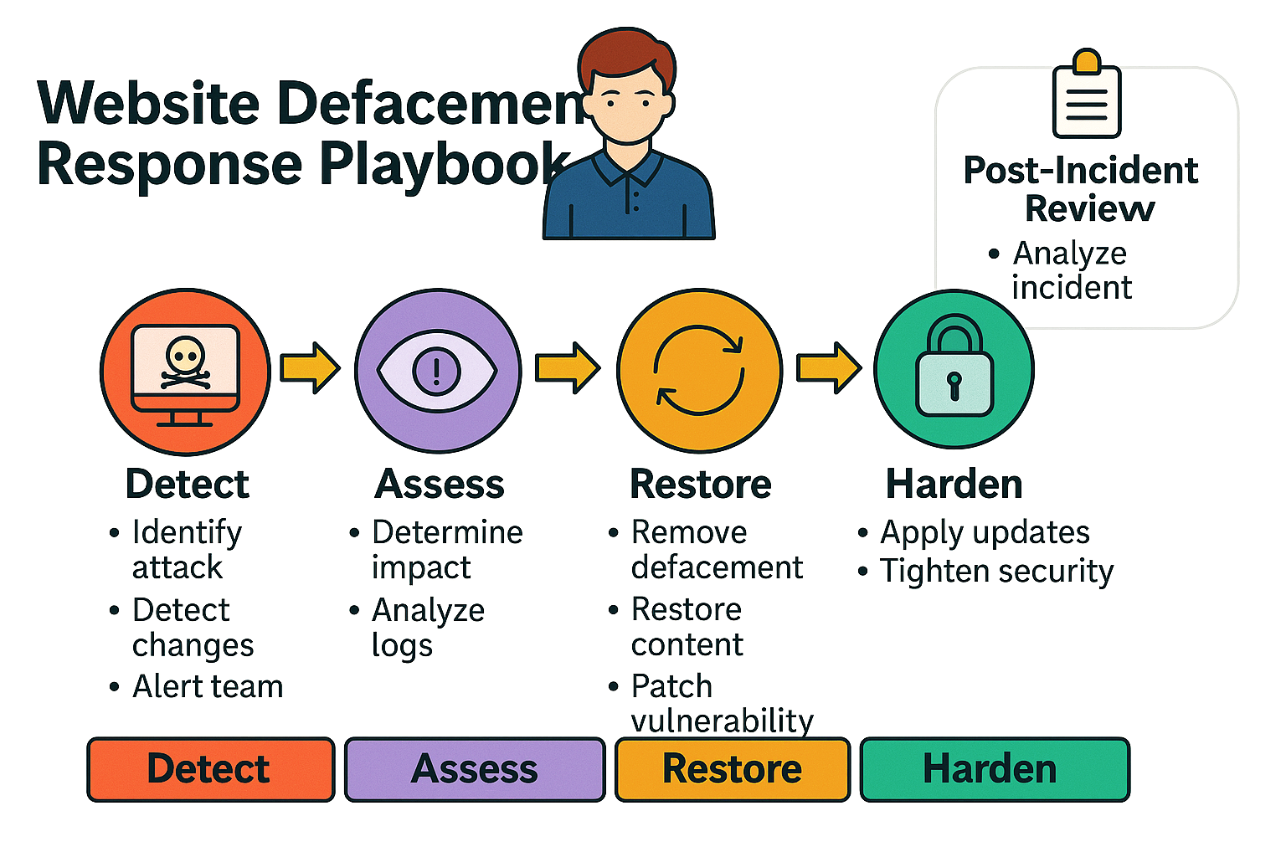
CAPSTONE PROJECT
Disclaimer: This training material belongs to techcrush and shouldn’t be shared

Slide 11
CAPSTONE PROJECT
Website Defacement Playbook: Benefits
Fast containment reduces reputational damage.
Restoring source control ensures data integrity.
Role clarity ensures there is quick action, minimal confusion.
Evidence-first method helps root-cause analysis and compliance.
Reference: 1.1 IR website Defacement full doc on google drive
Disclaimer: This training material belongs to techcrush and shouldn’t be shared

Slide 12
CAPSTONE PROJECT
Insider Threat Playbook: Design Rationale
Scope: Unauthorized Data Download Outside Business Hours
Phases: Detection (UEBA, DLP alerts) → Containment (suspend account, revoke access) → Eradication → Recovery → Review.
Clear Roles Separation: CISO, SOC, HR, Legal, Communications.
Focus: Evidence handling and fair HR coordination.
Disclaimer: This training material belongs to techcrush and shouldn’t be shared

Slide 13
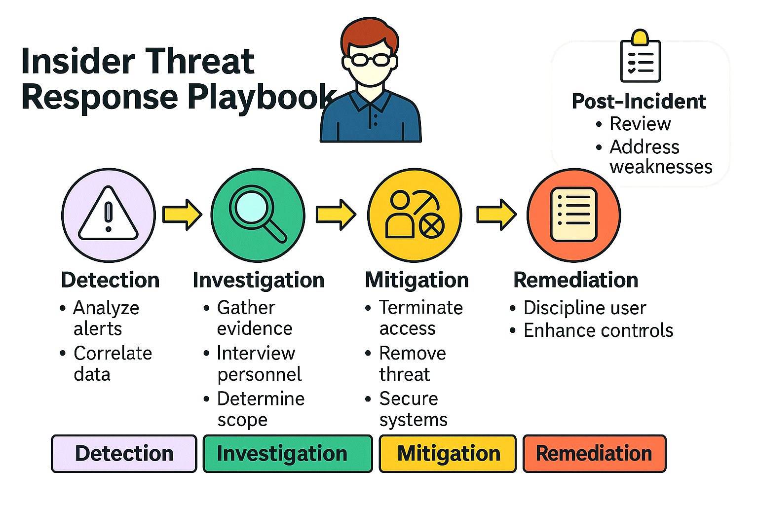
CAPSTONE PROJECT
Disclaimer: This training material belongs to techcrush and shouldn’t be shared

Slide 14
CAPSTONE PROJECT
Insider Threat Playbook: Benefits
Reduces insider risk through monitoring and behavioral analytics.
Improves proper chain of custody.
Enhances collaboration between HR, Legal, and IT.
Promotes policy reform and improves insider awareness.
Reference: 1.2 IR Insider Threat full doc on google drive
Disclaimer: This training material belongs to techcrush and shouldn’t be shared

Slide 15
CAPSTONE PROJECT
Phishing to Malware Delivery Playbook: Design Rationale
Scope: Covers phishing emails that drop malware or trojan infection.
Phases: Detection (email logs, EDR) → Containment (network isolation, IOC blocking) → Eradication → Recovery → Post-incident.
Clear Roles Separation: SOC, Forensics, Network, Legal, PR defined clearly to reduce confusion.
Communication: 1-hour IR notification, status updates every 4 hours.
Disclaimer: This training material belongs to techcrush and shouldn’t be shared

Slide 16
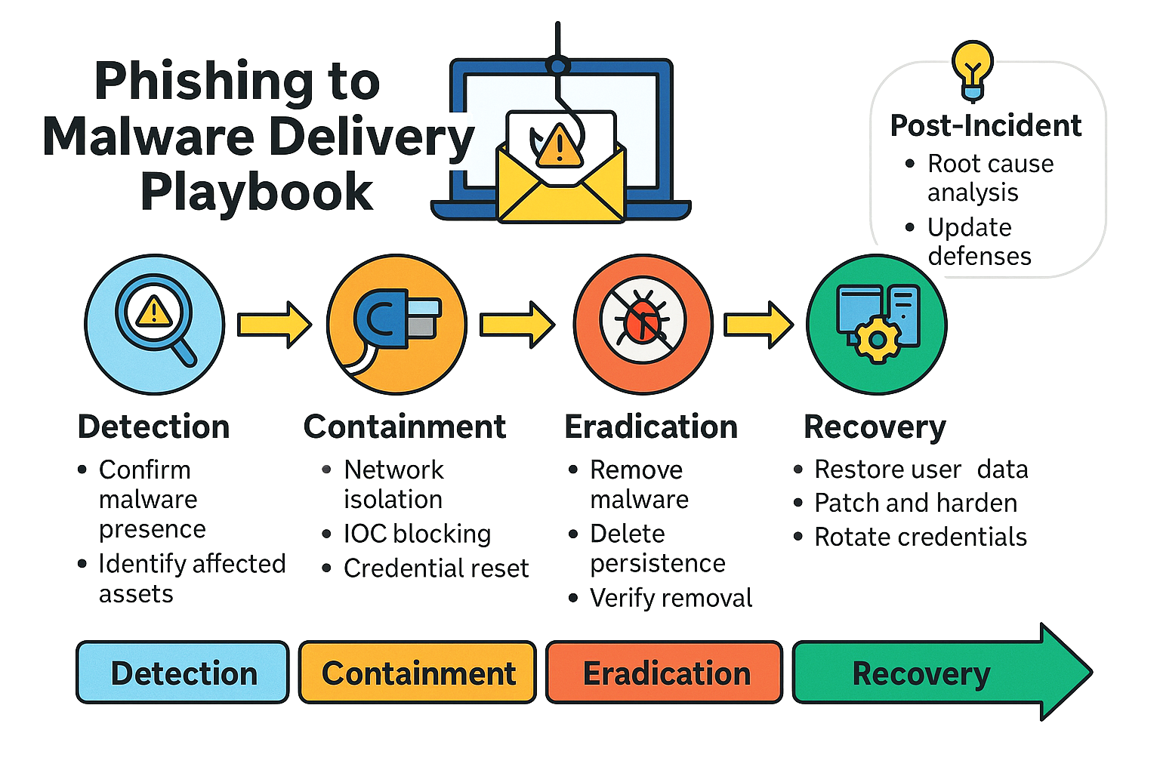
CAPSTONE PROJECT
Disclaimer: This training material belongs to techcrush and shouldn’t be shared

Slide 17
CAPSTONE PROJECT
Phishing to Malware Delivery Playbook: Benefits
Immediate network isolation limits spread.
Credential reset priority: Force password resets, revoke sessions, require MFA
Preserves forensic evidence for RCA and compliance.
Reduces downtime, increases user awareness, and strengthens email filtering rules.
Improves detection accuracy with SIEM + EDR integration.
Reference: 1.3 IR Phishing to Malware full doc on google drive
Disclaimer: This training material belongs to techcrush and shouldn’t be shared

Slide 18
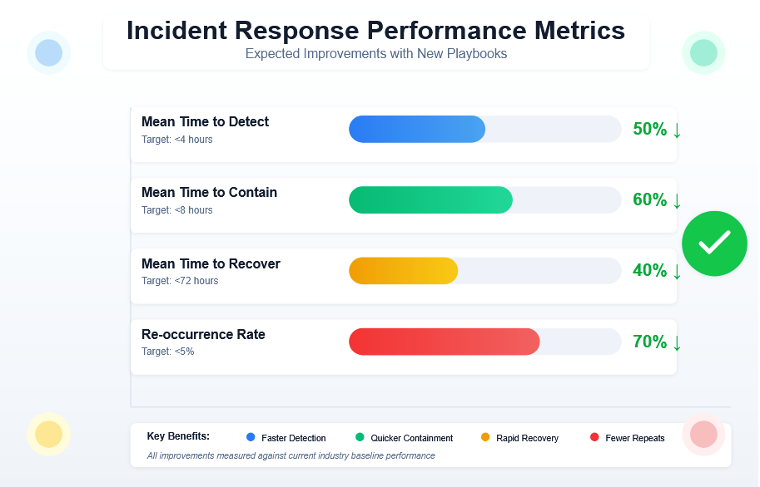
CAPSTONE PROJECT
Disclaimer: This training material belongs to techcrush and shouldn’t be shared

Slide 19
CAPSTONE PROJECT
Overall Benefits of Playbooks
1. Time saving: 50% time on detection, 60% on containment & 40% on recovery.
2. Staff knows what to do, Customer has more confidence in organization, management has visibility.
There is cost savings: less downtime, few repeat attacks.
CONTINUOUS IMPROVEMENT:
3. Learn from every incident, update defenses, stay ahead of hackers.
Disclaimer: This training material belongs to techcrush and shouldn’t be shared

Slide 20
CAPSTONE PROJECT
Conclusion
1. Structured Approach Reduces Chaos: Transforms reactive scrambling to coordinated execution
2. Evidence-First Philosophy Protects Organization: Supports legal action and regulatory compliance
3. Cross-Functional Collaboration Is Essential: Security, IT, HR, Legal, Communications work seamlessly
4. Metrics Drive Improvement: Enables continuous optimization
5. Playbooks Are Living Documents: Regular updates keep capabilities current
NEXT STEPS:
• Update & approve playbook for implementation.
• Begin training, testing the tools, system.
• Schedule first practice exercise within 60 days.
Disclaimer: This training material belongs to techcrush and shouldn’t be shared

Slide 21
CAPSTONE PROJECT
References
Template:Techcrush
Slide Notes:
NIST SP 800-61 Rev.2 — Incident Handling Guide.
MITRE ATT&CK Framework — Adversarial Tactics and Techniques.
ISO/IEC 27035 — Incident Management.
Internal Organizational Policies — IR SOPs and Risk Register.
Project Files:
IR Website Defacement (project 1.1)
Insider Threat Playbook (project 1.2)
Phishing to Malware Delivery (project 1.3)
Disclaimer: This training material belongs to techcrush and shouldn’t be shared

Slide 22
CAPSTONE PROJECT
THANK YOU
Disclaimer: This training material belongs to techcrush and shouldn’t be shared

